Slide 1
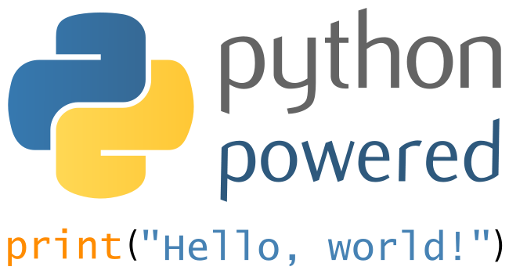
CONCEPTUAL PROGRAMMING
Lecture Introduction

Slide 2















Me me me me ….

Slide 3
Python
What is Python?
Why learn Python?
What Python can do?
Setup tools for Python
Understand versioning and backup

Slide 4
Overview

Slide 5
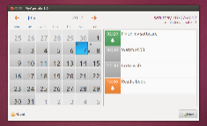
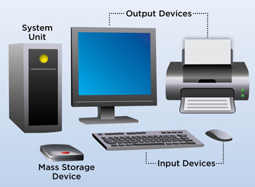


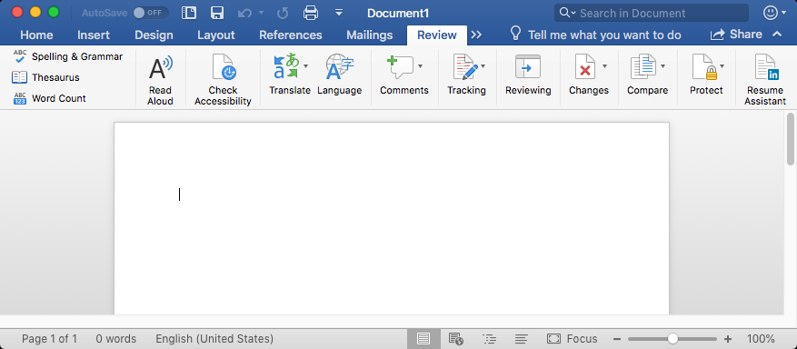

Why Program?
Computer – programmable machine designed to follow instructions.
Program – sequentially arranged set of instructions and decisions.
Computers execute very basic instructions in rapid succession.
Programming – the act of designing and implementing computer programs.
Programmer – person who writes programs to make computer perform a task.
Without programmers, no programs; without programs, a computer cannot do anything.
In this course you learn the rules and grammars to write a program via Python.
Non-programmable machines example
Car and coffee machine
Computer = programmable machines

Slide 6
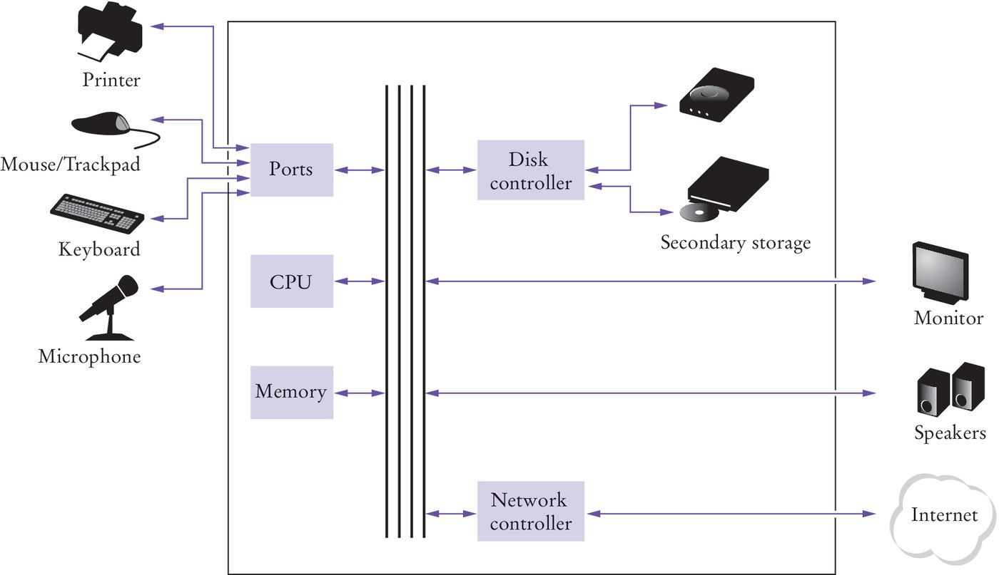
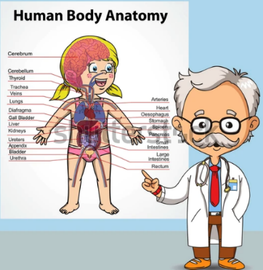


Schematic Design of a PC
Doctor study Mechanic Study
Human anatomy Car anatomy
Programmer study
Computer anatomy

Slide 7

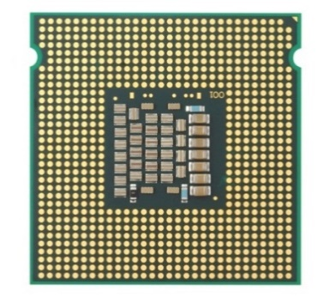
The Anatomy of a Computer
Storage devices include memory (RAM) and secondary storage:
Hard disk
Flash drives
CD/DVD drives
The central processing unit (CPU)
performs program control (e.g., fetching data) and data processing
(e.g., performing calculations)
Input / output devices allow the user to interact with the computer.
Mouse, keyboard, printer, screen …

Slide 8
When You ‘Run’ a Program
Program instructions and data (such as text, numbers, audio or video)
Stored on the hard disk, on a compact disk (or DVD), or
Elsewhere on the network.
When a program is started, it is brought into memory,
Where the CPU can read it.
The CPU runs the program one instruction at a time.
The program may react to user input.
As directed by these instructions and the user, the CPU
Reads data, modifies it, and
Writes it back to memory, the screen, or secondary storage.

Slide 9

When You ‘Run’ a Program
Book Shelf → Secondary Storage
It can hold large number of books
Brain → CPU
Left → Artistic
Right → Arithmetic
Table → Memory
Hold books currently in use
Return to shelf on completion (R/W)
Hands, Eyes → I/O
You bring a book from the shelf to the table read it, analyze it, take a note and return to shelf

Slide 10
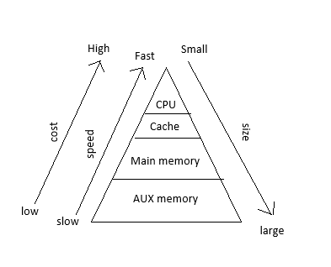
Why use different memory?
Trade of between speed, cost and size
CPU
Best
Cache
Main
Fast
Secondary
Too slow

Slide 11
Python

Slide 12


What is python?
Large snake, typically growing up to 25 feet (7.62 meters) or even larger.
비단뱀

Slide 13
The Python Language
In the early 1990’s, Guido van Rossum designed what would become the Python programming language.
Van Rossum was dissatisfied with the language available.
They were optimized to write large programs that executed quickly.
He needed a language that could not only be used to create programs quickly but also make them easy to modify.
It was designed to have a much simpler and cleaner syntax than other popular languages such as Java, C, and C++ (make it easier to learn).

Slide 14
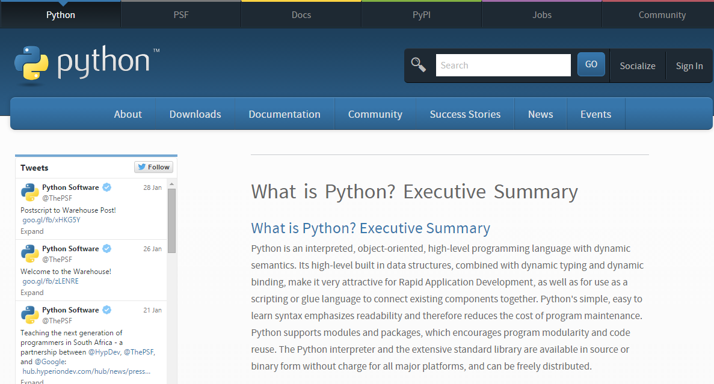

Slide 15
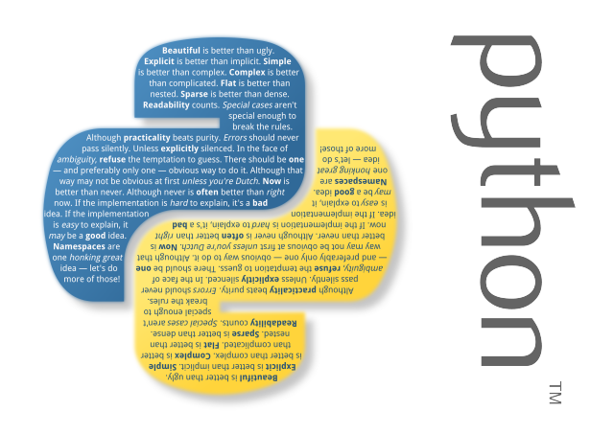
Python is …
Python is
Open source
High-level
Cross-platform
Dynamically Typed
Very expressive
Interpreted
Object-oriented

Slide 16
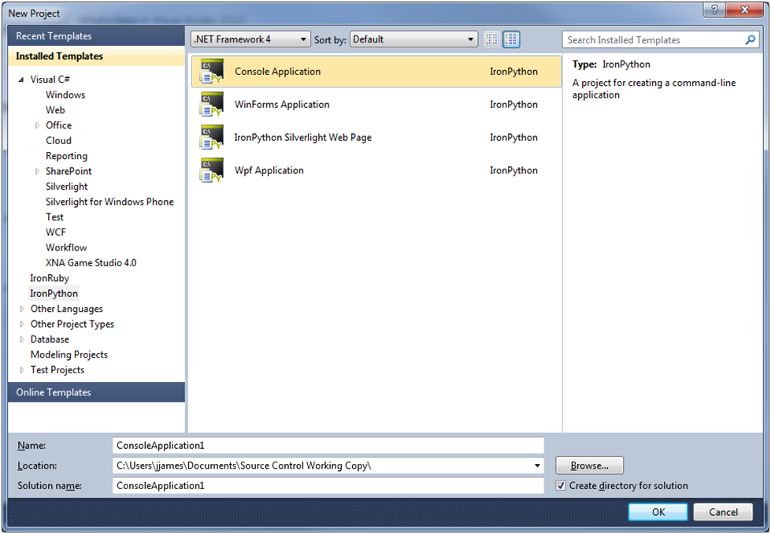
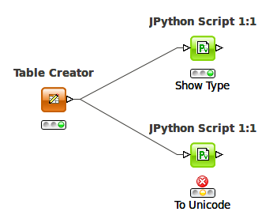
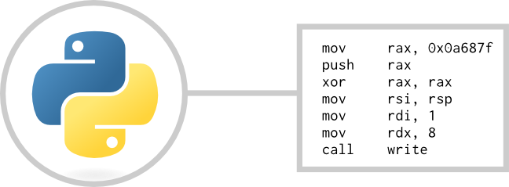
Open Source?
Python – language
CPython – implemented in C
JPython – runs in JVM
IronPython – implemented in C# and runs on .NET Framework

Slide 17
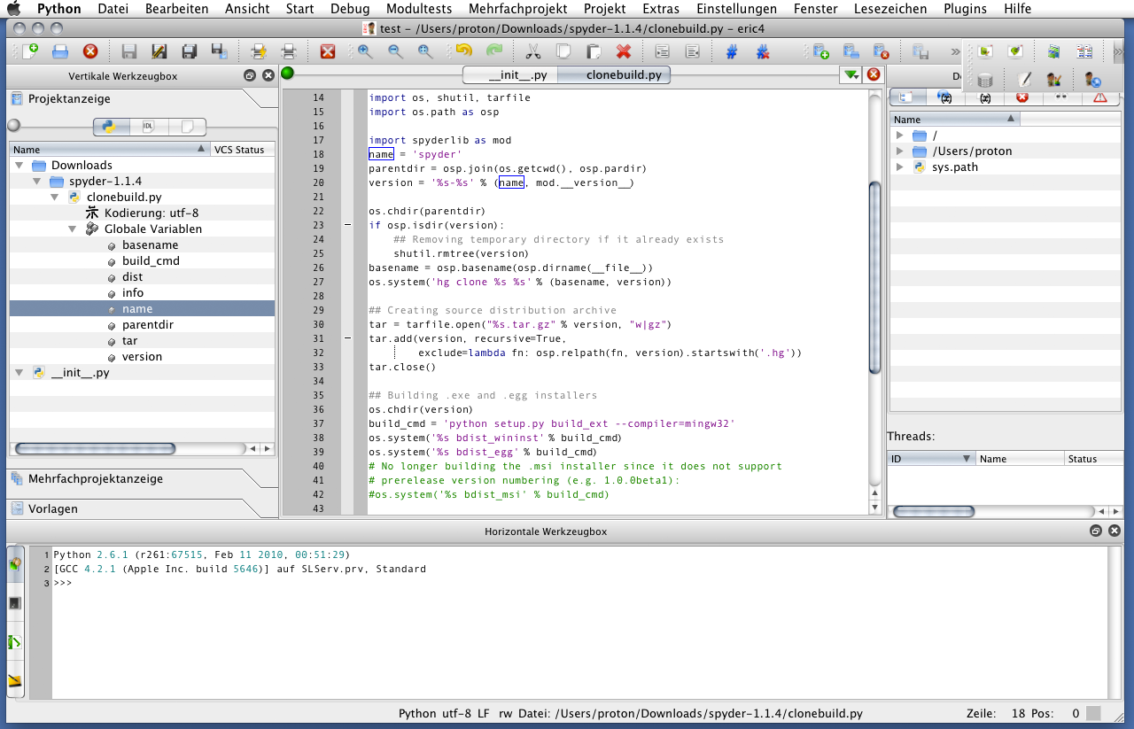
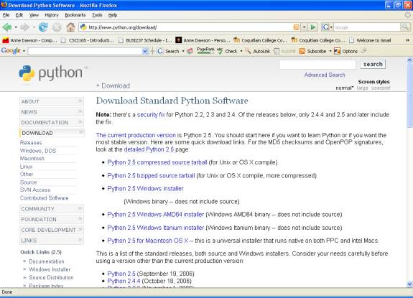




Cross-Platform

Slide 18
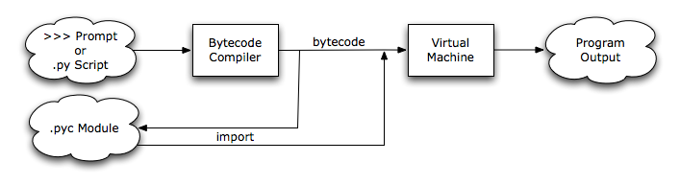
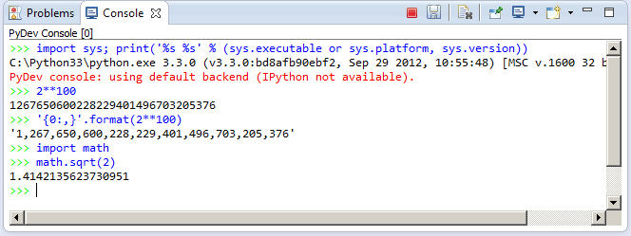
Interpreted

Slide 19
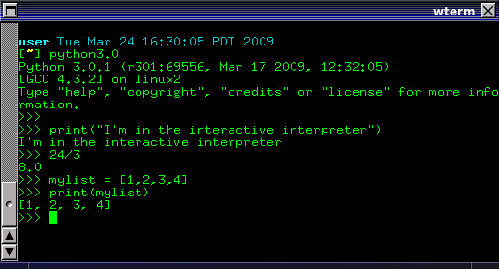
Dynamically Typed
C
int a, b, sum;
a = 3;
b = 5;
sum = a + b;
Python
a = 3
b = 5
sum = a + b
C
int num[3] = { 1, 2, 3, 4 };

Slide 20
High-Level
Python, Ruby
사용자 친화적
C, C++, C#
Python: close to language, English
sum = a + b
Assembly:
L2:
add r3, r1, 80
add r4, r1, 88
Machine: electric charge +/-
010110010110110101
Assembly Learning
Machine Learning
Hardware
기계친화적

Slide 21
Writing a program

Slide 22
Developing/Codding/Writing a Program
Writing a program requires
SW development kits (SDK)
Framework
Source Code editor
Debugger
An integrated development environment, or IDE,
Combine all the tools needed to write, compile, and debug a program into a single software application.
Examples are Microsoft Visual C++, Turbo C++, Explorer, CodeWarrior, etc.

Slide 23
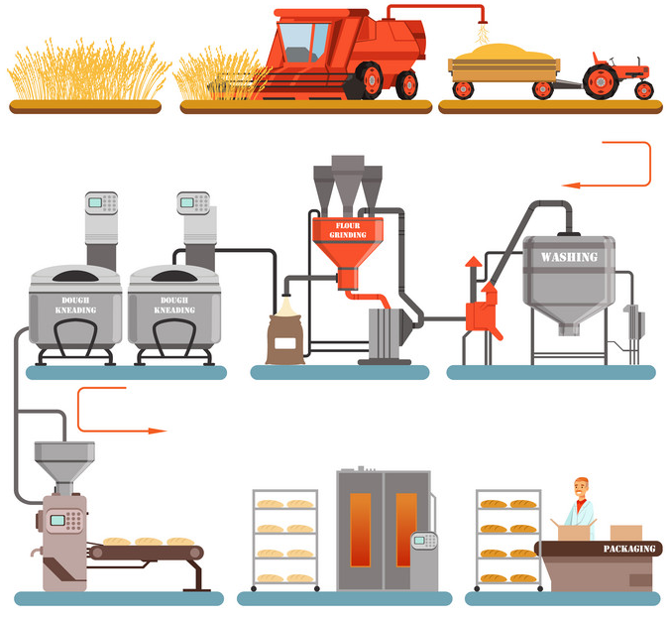
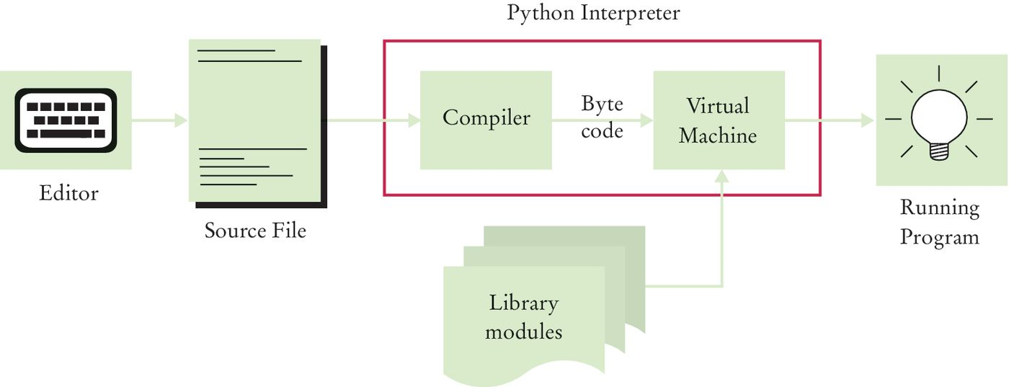
Source Code to Running Program
The interpreter/compiler generates byte code instructions (simple instructions for the virtual machine).
The virtual machine is a program that is similar to the CPU of your computer.
Any necessary libraries (e.g., for drawing graphics) are automatically located and included by the virtual machine.

Slide 24
Developing/Codding/Writing a Program
For this course
VS Code
With python and other extensions
Python interpreter
To translate and run to program

Slide 25










House vs. Software/Program
Product
Tools
Raw Material

Slide 26
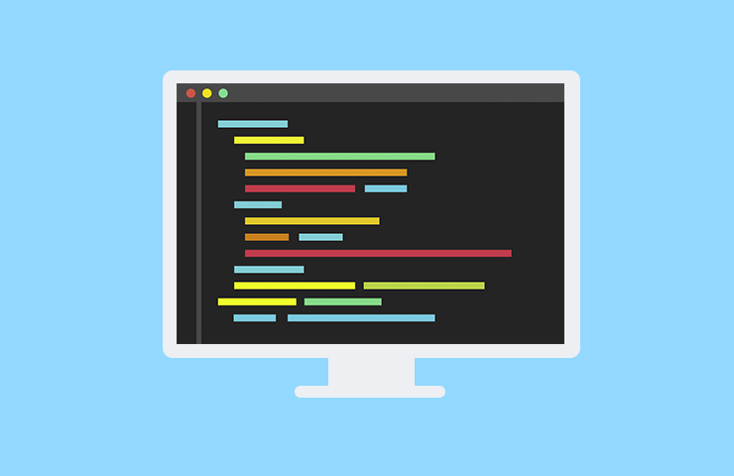


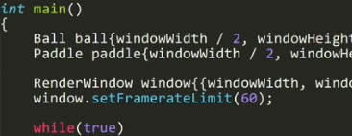
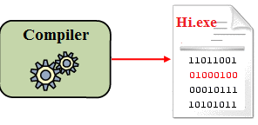
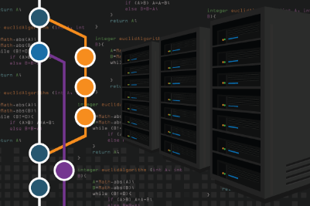
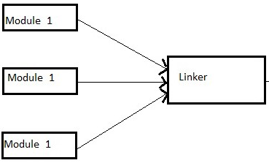
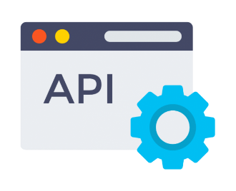
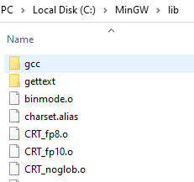


House vs. Software/Program

Slide 27
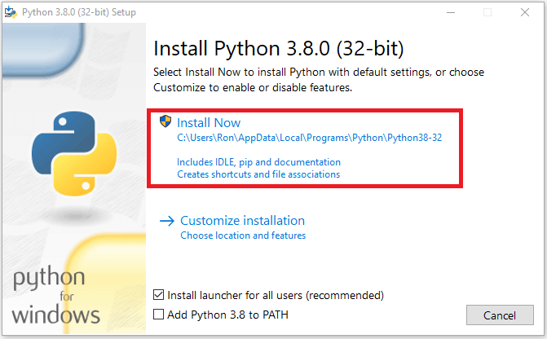
Installing python
Download python
https://www.python.org/downloads/
Run the exe
Add Python to Path
Follow default setup

Slide 28
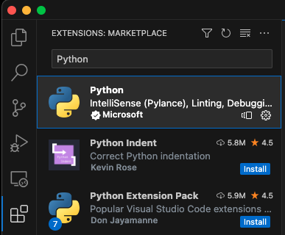



Setup development environment
Download and install VSCode IDE
https://code.visualstudio.com/
Open vs code
Click the extension Icon OR
File → Preferences → extension
Search and install
Python → from Microsoft
Jupyter
Code runner
Think of IDE as a toolbox
Holds all types of tools

Slide 29
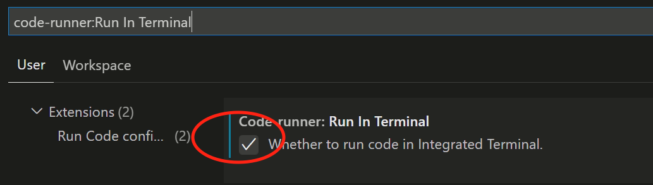
Configure Code runner
Go to File → Preferences → Settings
search → "code-runner:Run In Terminal”
Enable → "Whether to run code in Integrated Terminal" option.

Slide 30
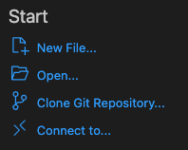
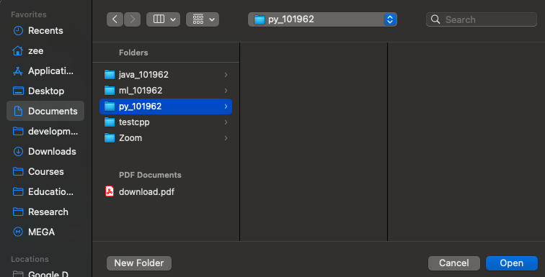



Creating Project
From the welcome window select → open folder OR
From menu: File → Open Folder
Go to documents folder
Create → New Folder
Rename it → py_<student_id>
E.g. py_101962
Select the folder
Click open

Slide 31
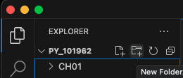
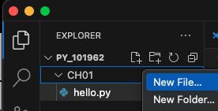



Creating files and directories
Create folder for chapter one → CH01
Click the add folder icon OR
Right click → empty space
Create new folder
Create new file under CH01
Right click CH01 → create a new file
hello.py
Type this code on hello.py
#my first python program print("Hello World")

Slide 32
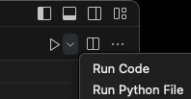
Run the code
Find the play/run icon → top right corner
Only for the first time
Select the drop down → click → Run Python File
To run next time → just select play/run icon
This program prints in the console
N.B. We’ll discuss what just happened later ☺

Slide 33
Jupyter

Slide 34
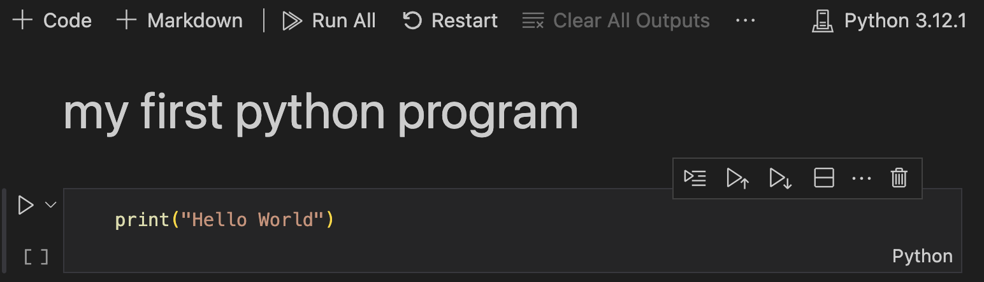
Jupyter Notebook
Overview of Jupyter Notebook Documents:
Combines computer code (e.g., Python) with rich text elements (paragraphs, equations, figures, links).
Serves as both human-readable documents with detailed analysis and results.
Executable documents capable of performing data analysis upon running.
File extension → *.ipynb
Your first notebook
Create hello.ipynb under CH01
Create a markdown selection
Create a code section
Select kernel → run the program

Slide 35
First program

Slide 36
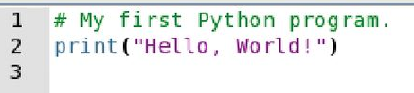
Analysing Your First Program
A Python program contains one or more lines of instructions (statements) that will be translated and executed by the interpreter.
The first line is a comment (not a statement but instead it provides descriptive information about the program to programmers).
The second line contains a statement that prints a line of text on screen “Hello, World!”.

Slide 37
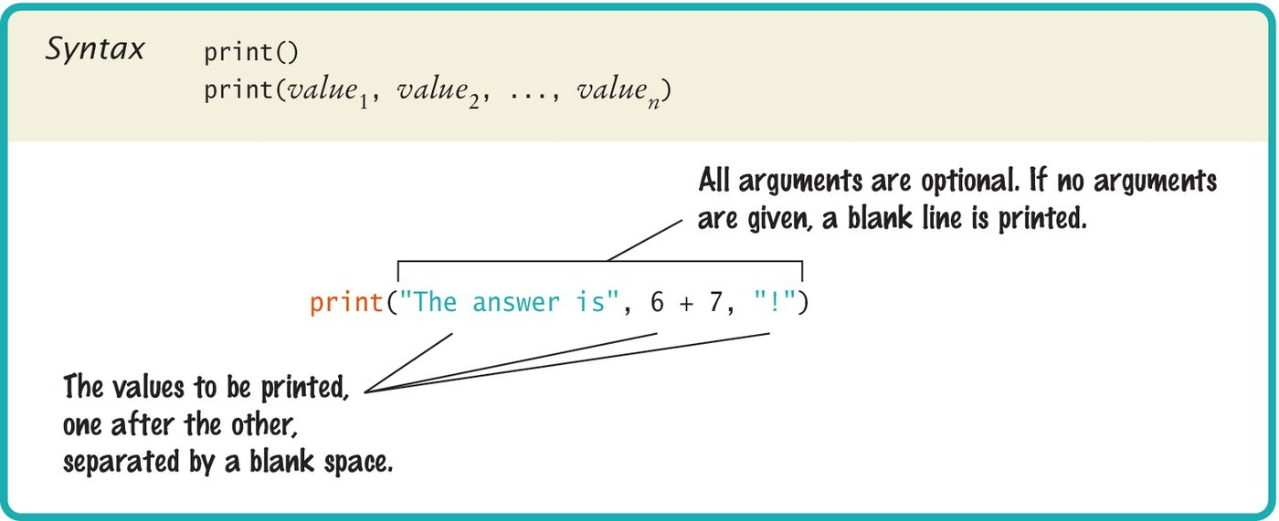
Python Programs
Using Python ‘print()’ function.
A function is a collection of programming instructions that carry out a particular task (in this case to print a value on screen).
It’s code that somebody else wrote for you!

Slide 38
Python Functions
To use, or call, a function in Python you need to specify:
The name of the function that you want to use (in previous example, the name was print).
Any values (arguments) needed by the function to carry out its task (in this case, “Hello World!”). Arguments are enclosed in parentheses () and multiple arguments are separated with commas.

Slide 39
Errors
Two categories of errors:
Compile-time Errors
Syntax Errors: spelling, capitalization, punctuation, ordering of statements, matching of parenthesis, quotes …
No executable program is created by the compiler
Correct first error listed, ten compile again. Repeat until all errors are fixed.
Run-time Errors
Logic Errors
Program runs, but produces unintended results
Program may ‘crash’

Slide 40
Syntax Errors
What happens if you
Misspelled a word: Print(“Hello World!”)
Leave out quotes: print(Hello World!)
Mismatch quotes: print(“Hello World!’)
Don’t match brackets: print(‘Hello’
Try it!

Slide 41
Logic Errors
What happens if you
Divide by zero: print(1/0)
Misspelled output: print(“Hello, Word!”)
Try it! Program will compile and run, but the output is not as expected!

Slide 42
Algorithm Design
Before you write a program, write an algorihtm
Algorithms are simply plans
Detailed plans that describe the steps to solve a specific problem.
You already know quite a few
Calculate the area of a circle
Find the length of the hypotenuse of a triangle
Some problems are more complex and require more steps
Calculate PI to 100 decimal places
Calculate the trajectory of a missile

Slide 43
Pseudocode
start
input hours
BEGIN
input hours
input rate
pay = hours * rate
print pay
END
input rate
pay = hours * rate
end

Slide 44
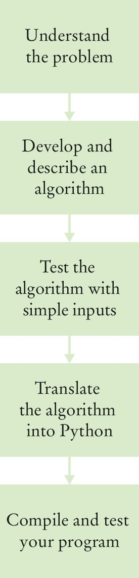
Algorithm Defined
An algorithm describes a sequence of steps that is:
Unambiguous
Do not require “assumptions”.
Uses precise instructions.
Executable
Can be carried out in practice.
Terminating
Will eventually come to an end.

Slide 45
Reasons

Slide 46
4 Reasons To Learn Python
Easy to learn
Python reads like kindergarten math.
Use of white space and common expression has eliminated.
Python require less code to complete basic tasks.
Python code is 3-5 times shorter than Java, 5-10 times shorter than C++.
Has ample of collection of resources online.

Slide 47
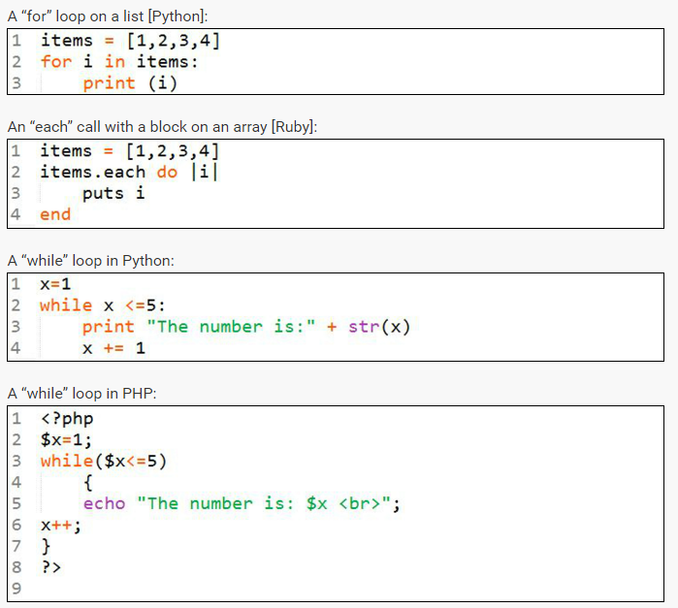
4 Reasons To Learn Python
Stepping Stone

Slide 48
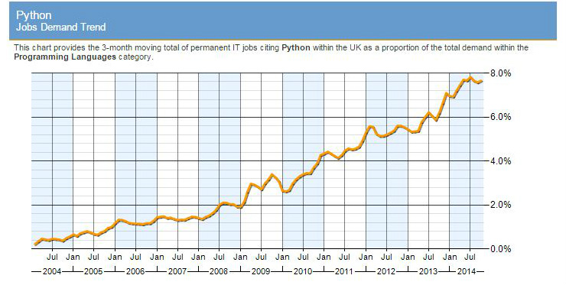
4 Reasons To Learn Python
Money Money Money

Slide 49
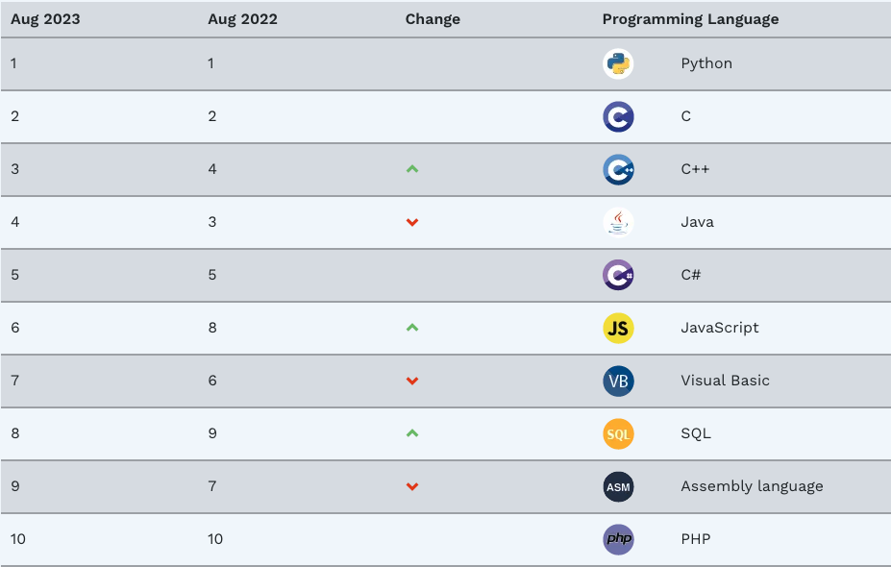
4 Reasons To Learn Python
Money Money Money
Companies such as Google, Yahoo!, Disney, Nokia, and IBM all use Python.
In New York, Python developers ranked #4 of most in-demand tech workers.

Slide 50

4 Reasons To Learn Python
Works Online!
Django – the popular open source web application framework written in Python – is the foundation of such sites as Pinterest, The New York Times, The Guardian, Bit Bucket, and Instagram.

Slide 51
Organizing

Slide 52
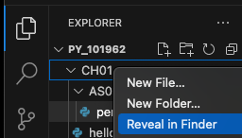
Organizing your work
Your ‘source code’ is stored in .py files
Create one folder per chapter
A program can consist of several .py files
There maybe other folders inside each chapter
Be sure you know where your IDE stores your files
You need to be able to find you files
To find file or path
Right click on file or path → select
Reveal in Explorer(Win)
Reveal in Finder(Mac)

Slide 53
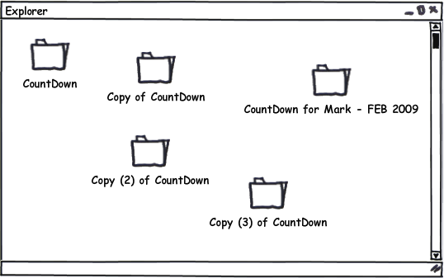
The Problem: Patching
Maintaining group Projects
Patches are mostly sent via email
Difficult to roll back
Hard maintain
As the number of people working in the project is large
Testing new unstable features

Slide 54
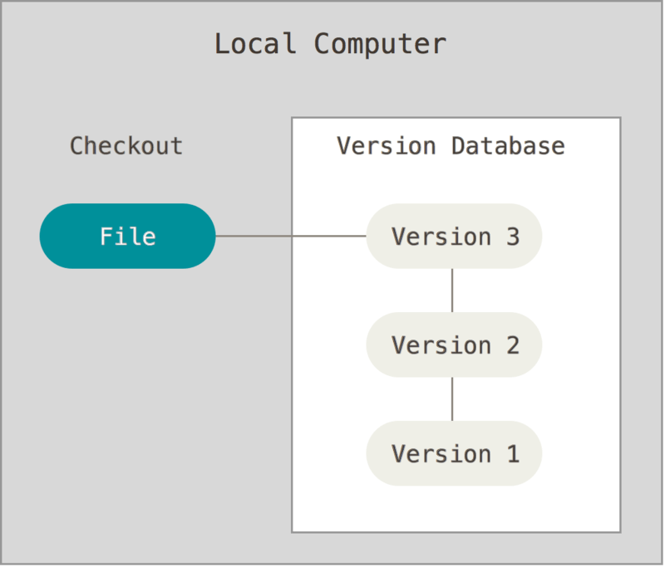
The solution: Version Control
A method for recalling versions of a codebase
Keeping a record of changes
Who did what and when in the system
Save yourself when things inevitably go wrong

Slide 55
Version Control: Why?
Individual
Back-ups of the project
Create a “checkpoint” in the project at any stage
Fearlessly modify code
Tagging: Mark certain point in time
Branching: Release versions and continue development
Team
Everything in “Individual”
Allow multiple developer to work on the same codebase
Merge changes across same files: handle conflicts
Check who made which change: blame/praise

Slide 56
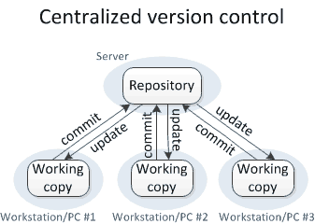
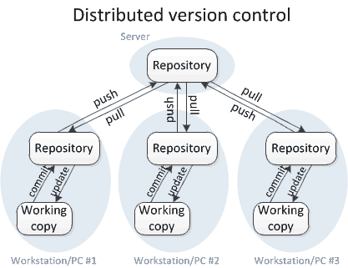
Centralized Vs. Distributed VCS
Concurrent Version System (CVS)
Subversion (SVN)
Git
Mercurial

Slide 57
History of Git
Came out of Linux development community
Linus Torvalds, 2005
Initial goals:
Speed
Support for non-linear development (thousands of parallel branches)
Fully distributed
Able to handle large projects like Linux efficiently
Notes:
Initial goals were to support development of Linux

Slide 58
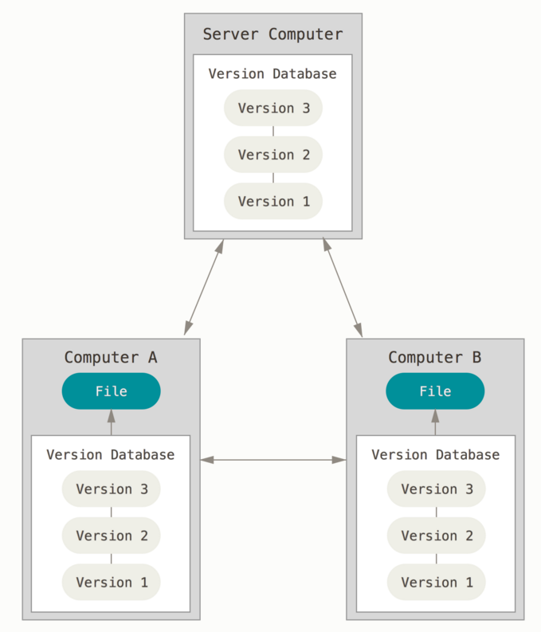
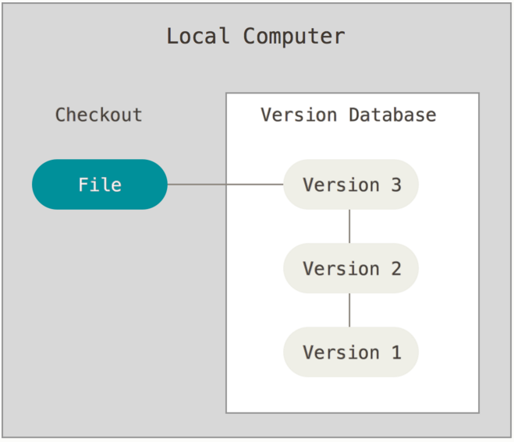
Ways to use Git
Possible servers:
Github
Bitbucket
AWS CodeCommit
…
Using Git on multiple computers, multiple users or one user on multiple computers
Using Git on your own computer, one user

Slide 59
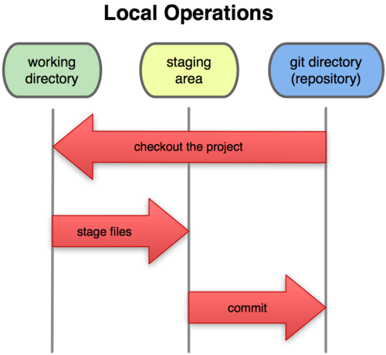
A Local Git project has three areas
Unmodified/modified Files
Staged Files
Committed Files
Note: working directory sometimes called the “working tree”, staging area sometimes called the “index”.

Slide 60

Git file lifecycle

Slide 61
Basic Workflow
Basic Git workflow:
Modify files in your working directory.
Stage files, adding snapshots of them to your staging area.
Do a commit,
Takes the files as they are in the staging area
Stores that snapshot permanently to your local Git directory (your local copy of the repo).
Do optional push → for project with remote repository
Notes:
If a particular version of a file is in your local git directory, it’s considered committed.
If it’s modified but has been added to the staging area, it is staged.
If it was changed since it was checked out but has not been staged, it is modified.

Slide 62
Get ready to use Git!
Set the name and email for Git to use when you commit:
$ git config --global user.name “Bugs Bunny”
$ git config --global user.email bugs@gmail.com
You can call git config –-list to verify these are set.
These will be set globally for all Git projects you work with.
You can set variables on a project-only basis by not using the --global flag.
The latest version of git will also prompt you that push.default is not set
To make this warning go away with:
$ git config --global push.default simple

Slide 63
Create a local copy of a repo
Two common scenarios: (only do one of these)
To clone an already existing repo to your current directory:
$ git clone <url> [local dir name]
Creates a directory named local dir name
Example: git clone https://github.com/zizutg/py_101962
To create a Git repo in your current directory:
$ git init
This will create a .git directory in your current directory
Then you can commit files in your current directory into the local repo:
$ git add [filename] or “.” for adding all
$ git commit –m “initial project version”

Slide 64
Git commands
command | description
git clone url [dir] | copy a git repository so you can add to it
git add files | adds file contents to the staging area
git commit | records a snapshot of the staging area
git status | view the status of your files in the working directory and staging area
git diff | shows diff of what is staged and what is modified but unstaged
git help [command] | get help info about a particular command
git pull | fetch from a remote repo and try to merge into the current branch
git push | push your new branches and data to a remote repository
others: init, reset, branch, checkout, merge, log, tag

Slide 65
Adding & Committing files
The first time we ask a file to be tracked, and
Every time before we commit a file we must add it to the staging area:
$ git add README.txt hello.py
This takes a snapshot of these files at this point in time and adds it to the staging area.
Note: To unstage a change on a file before you have committed it:
$ git reset HEAD filename
To move staged changes into the local repo we commit:
$ git commit –m “Fixing bug #22”
Note: Can edit the most recent commit message → if not pushed yet using: git commit –-amend
Note: These commands are just acting on your local version of repo.
Notes:
Note: To unstage a change on a file before you have committed it:
$ git reset HEAD filename
Note: To unmodify a modified file:
$ git checkout -- filename

Slide 66

Use Good Commit Messages
http://xkcd.com/1296/
Notes:
http://xkcd.com/1296/

Slide 67
Status and Diff
To view the status of your files in the working directory and staging area:
$ git status or $ git status –s (-s shows a short one line version)
To see difference between your working directory and the staging area
This shows what is modified but unstaged
$ git diff
Difference between the staging area and your local copy of the repo
This shows staged changes (--staged is synonymous)
$ git diff --cached
Notes:
Git diff HEAD will show diff between working tree and staging area vs. the repo

Slide 68
Viewing logs
To see a log of all changes in your local repo:
$ git log or
$ git log --oneline (to show a shorter version)
1677b2d Edited first line of readme
258efa7 Added line to readme
0e52da7 Initial commit
git log -5 (to show only the 5 most recent updates, etc.)
Note: changes will be listed by commitID #, (SHA-1 hash)
Note: changes made to the remote repo before the last time you cloned/pulled from it will also be included here

Slide 69
Repositories
Repository (aka “repo”): a location storing a copy of all files.
Can be local or remote
you don't edit files directly in the repo;
you edit a local working copy or “working tree”
then you commit your edited files into the repo
There may be only one repository that all users share (CVS, Subversion)
Or each user could also have their own copy of the repository (Git, Mercurial)
Files in your working directory must be added to the repo in order to be tracked.

Slide 70
GitHub?
GitHub.com is a site/host for online/remote storage of Git repositories.
Many open source projects use it, such as the Linux kernel.
You can get free space for open source projects or you can pay for private projects.
Question: Do I have to use GitHub to use Git?
Answer: No!
Git can be used completely locally for your own purposes, or
Share a repo with users on the same file system
As long as everyone has the needed file permissions.

Slide 71
GitHub?
Connecting to remote repo
Create an account on github.com → if you did not already have
Create a repository and copy the URL
E.g. → https://github.com/zizutg/py_1019
Add remote URL to the local repo
git remote add origin [repo-url]
Good practice:
Add and Commit your changes to your local repo
Pull from remote repo to get most recent changes
Fix conflicts if necessary, then add and commit those changes to your local repo
In case someone has made a change → not important for individual project
Push your changes to the remote repo

Slide 72
Pulling and Pushing
To fetch the most recent updates from the remote repo into your local repo, and put them into your working directory:
$ git pull origin master
To push your changes from your local repo to the remote repo:
$ git push origin master
Notes: origin = an alias for the URL you cloned from
master = the remote branch you are pulling from/pushing to, (the local branch you are pulling to/pushing from is your current branch)
Notes:
$ git remote -v
origin https://github.com/rea2000/santalist.git (fetch)
origin https://github.com/rea2000/santalist.git (push)

Slide 73
Branching
To create a branch called experimental:
$ git branch experimental
To list all branches: (* shows which one you are currently on)
$ git branch
To switch to the experimental branch:
$ git checkout experimental
Later on, changes between the two branches differ, to merge changes from experimental into the master:
$ git checkout master
$ git merge experimental
Note: git log --graph can be useful for showing branches.
Note: These branches are in your local repo!

Slide 74
Summary: Computer Basics
Computers execute very basic instructions in rapid succession.
A computer program is a sequence of instructions and decisions.
Programming is the act of designing and implementing computer programs.
The central processing unit (CPU) performs program control and data processing.
Storage devices include memory and secondary storage.

Slide 75
Summary: Python
Python was designed in a way that makes it easier to learn than other programming languages such as Java, C, and C++.
This was done by giving it a much simpler and cleaner syntax.
Set aside some time to become familiar with the programming environment that you will use for your class work.
An editor is a program for entering and modifying text, such as Python program.

Slide 76
Summary: Python
Python is case sensitive. You must be careful about distinguishing between upper and lowercase letters.
The Python compiler translates source code into byte code instructions that can be executed by the virtual machine.
A function is called by specifying the name and its parameters.
A string is a sequence of characters enclosed in quotation marks.

Slide 77
Summary: Errors
A compile-time error is a violation of the programming language rules that is detected by the compiler.
A run-time error causes a program to take an action that the programmer did not intend.
Pseudocode is an informal description of a sequence of steps for solving a problem.
An algorithm for solving a problem is a sequence of steps that is ambiguous, executable, and terminating.

Slide 78
Summary: Algorithm
A compile-time error is a violation of the programming language rules that is detected by the compiler.
A run-time error causes a program to take an action that the programmer did not intend.
Pseudocode is an informal description of a sequence of steps for solving a problem.
An algorithm for solving a problem is a sequence of steps that is ambiguous, executable, and terminating.

Slide 79

Assignment
Under CH01 create another folder → AS<X>_<Student ID>
E.g. AS01_101962
Create file → personal_info.py
Write a program that displays your student information as follows
*************************************
Name: XXXX XXX XXXX ID: XXXXXXX Phone: XXX XXXX XXXX Department: XXXXXXX XXXXXX Grade: XXXXXXXXXXXX Github link: XXXXXXXXXXXXXXX
*************************************
Submission → Zip the folder → AS<X>_<Student ID>
Submit on Moodle

Slide 80


END
# Any Questions?

